Slide 1


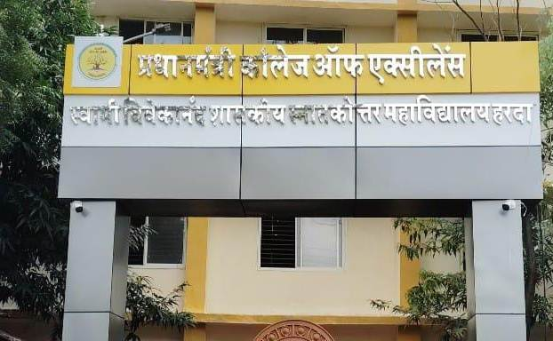
Pradhanmantri College of Excellence
Swami Vivekananda Govt. P. G. College, Harda
students Placment

Slide 2
students Placment
Sr. | Name of Student | Name of the qualifying exam
01 | Seema | Delhi Police( Constable)
02 | Bhawna Bhatrawanshi | NET
03 | Abhinav Rajput | High School Teacher
04 | Chattu Battu | GDS Khandwa
05 | Pushpendra Kushwah | Western Railway
06 | sarika Bundela | Indian Post office
07 | Rohit singh Yadav | Indian Railway
08 | Chetan Anand gour | Central Railway
09 | Sanju S/O Tula | Police Constable of MP Police
10 | Meena D/o Chentram | Office of the Inspector General, Northern Frontier ITB Police Dehradun-248146
11 | Balram Uikey | SSC Selection Centre North
13 | Chandrashekhar s/o Jagdeesh Prasad | West Central Railway Jabalpur
13 | Rajendra s/o Gangavishgan | West Central Railway Kota
14 | Anjali kaithwas | Western Railway Baroda
Sr. | Name of Student | Name of the qualifying exam
15 | Gopal Nagvel | Central Railway
16 | Sarika Bundela | GDS
17 | Rohit singh Yayav | NTPC
18 | Chetan Anand Gour | Central Railway
19 | Amit Kishore | Western Railway
20 | Meena D/o Chentram
21 | Sanju | Police Constable
22 | Anop singh | NTPC
23 | Balram | SSC
24 | Bhawani Singh | Railway
25 | Anup Singh Dhanore | West Central Railway Jabalpur
26 | Saloni Bhagre | Sub-Divisional Office Khandwa
27 | Aseem Vishwakarma | Sub-Divisional Office Bhopal
28 | Nishant Kumar Agarwal | Sub-Divisional Office Bhopal
Sr. | Name of Student | Name of the qualifying exam
30 | Ashish | M.P. Police Constable
31 | Brahmakalam | M.P. Police Constable
32 | Shubham | M.P. Police Constable
33 | Shree Kishan Chouhan | M.P. Police Constable
34 | Bharat Kumar Patnare | M.P. Police Constable
35 | Annul al chouhan | M.P. Police Constable
36 | Bhagat singh | M.P. Police Constable
37 | Manoj | M.P. Police Constable
38 | Jagnupandram | M.P. Police Constable
39 | Sohil | M.P. Police Constable
40 | Mukesh Kumar | M.P. Police Constable
41 | Vashanav Sarate | M.P. Police Constable
42 | Ayushi Shukla | M.P. Police Constable
43 | Aman Vishhawakarma | M.P. Police Constable

Slide 3
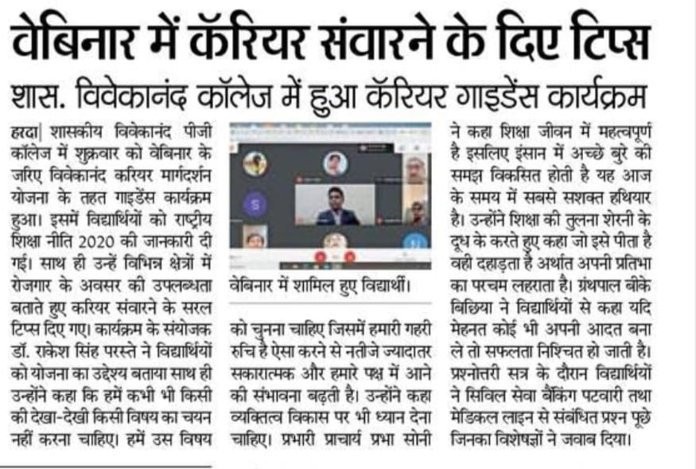
students Placment
Sr. | Name of Student | Name of the qualifying exam
44 | Deepika sengar | MP Education department
45 | AAFREEN SHAIKH | STATE BANK OF INDIA
46 | शैलेष कुमार | अमृतश्री महाविद्यालय, टिमरनी
47 | Shailesh Kumar | Amritshree College of Excellence, Timarni
48 | Balkrishna | राजस्व विभाग
49 | Sanju S/O Tula | Police Constable of MP Police
50 | Vaishnavi Lahore | Genre education system Harda
51 | Deepika sengar | MP Education department
52 | Kamlesh Chauhan | Pradhanmantri college
53 | AAFREEN SHAIKH | STATE BANK OF INDIA
54 | Sonali kushwaha | Buldana urban co. Op.cr. society LTD Buldana Harda
55 | शैलेष कुमार | अमृतश्री महाविद्यालय, टिमरनी
56 | Shailesh Kumar | Amritshree College of Excellence, Timarni
57 | Balkrishna | राजस्व विभाग
58 | Pallavi | Revenue department
59 | Uttam | Govt. College Harda

Slide 4

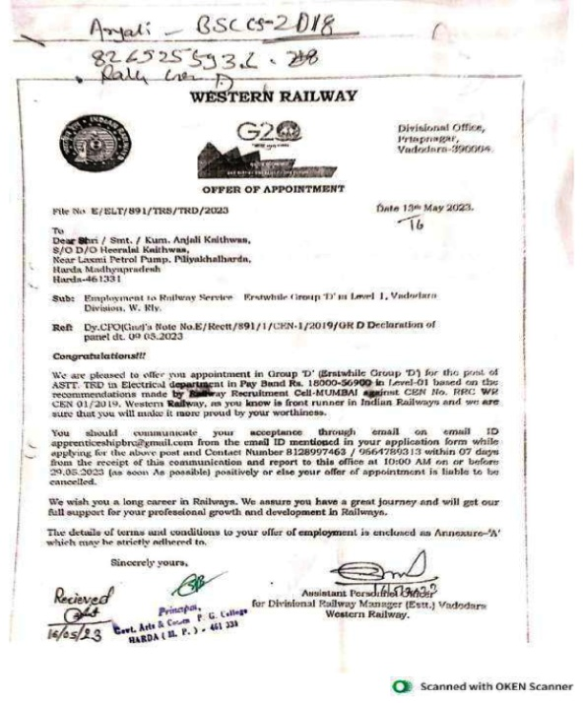
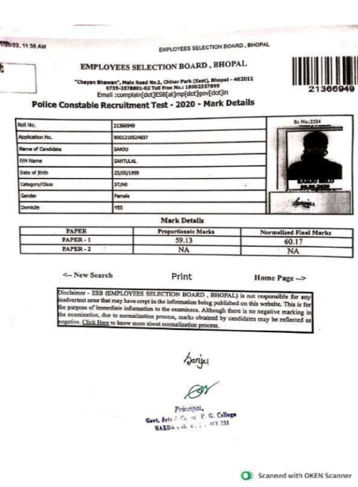
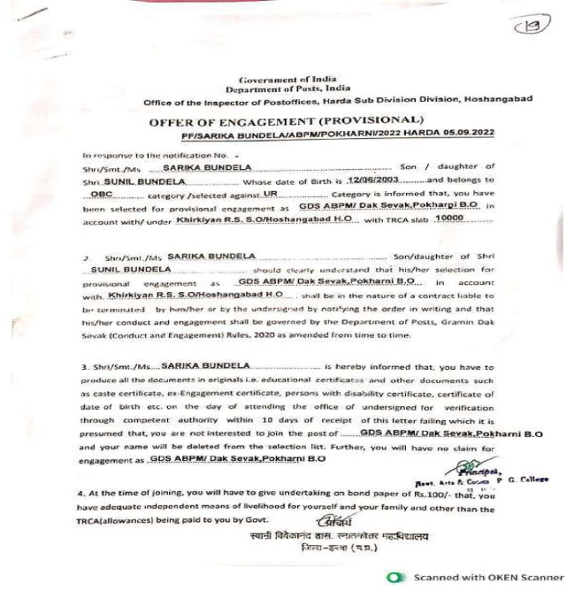
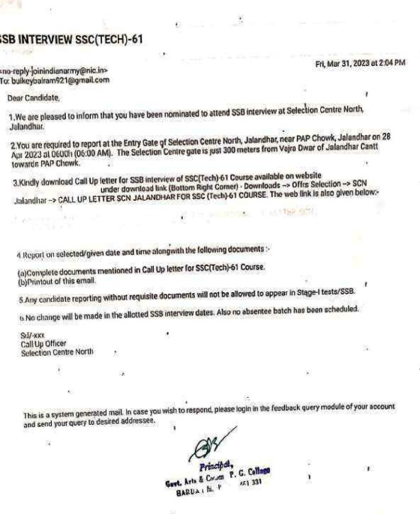
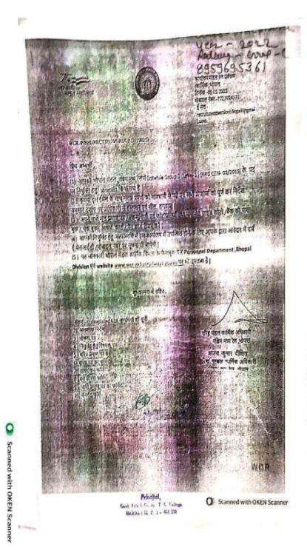
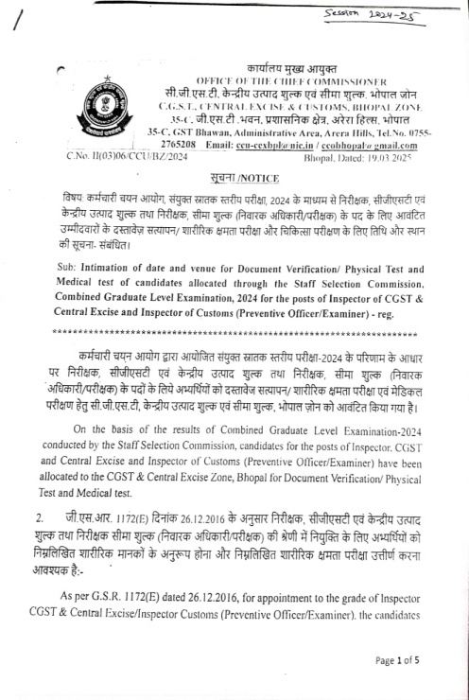
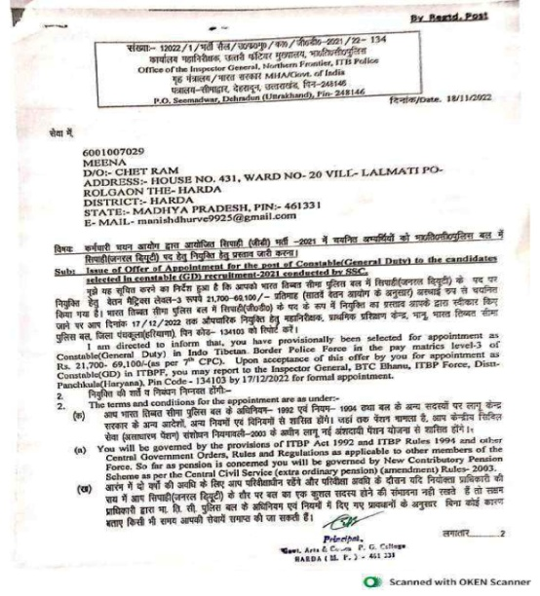
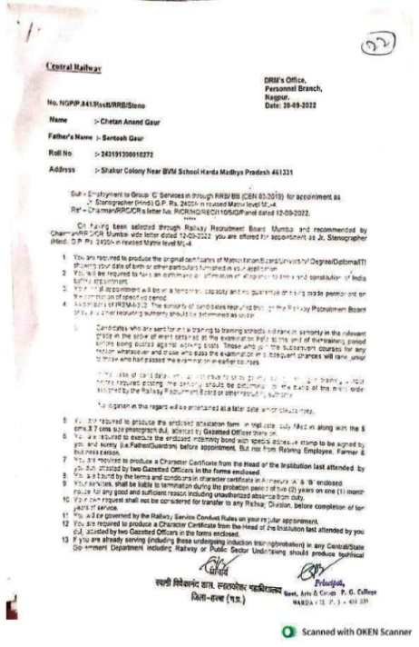

Slide 5

